Slide 1
Final Review on FLEET MANAGEMENT: SUPERVISED VS. UNSUPERVISED LEARNING WITH RANDOM FOREST AND KMEANS
Under the Guidance of
Dr. Pavan Kumar Pagadala
Assistant Professor
Computer Science and Engineering Department
KL Hyderabad Off Campus, Aziz Nagar ,Hyderabad
Danam Sree Mahima | 2010030336

Slide 2
Overview
Introduction
Objectives of the Project
Proposed Methodology/Architecture/Algorithm/Technique/etc
Implementation Details
Results (If any one objective is completed)
Future Scope
References

Slide 3
Introduction
Supervised learning in fleet management utilizes labeled data for training models to predict vehicle performance, maintenance needs, and optimize routes based on historical information.
Unsupervised learning in fleet management involves using unlabeled data to identify patterns, anomalies, and hidden relationships within the fleet data, aiding in clustering vehicles based on similarities and discovering insights without predefined labels.
Random Forest, a supervised learning algorithm, is effective in fleet management for accurate predictions by aggregating multiple decision trees, while K-Means clustering, an unsupervised technique, helps segment vehicles into clusters based on features like mileage, fuel consumption, or maintenance history.

Slide 4
Objectives of the Project
Enhance predictive accuracy for vehicle performance and maintenance scheduling.
Identify hidden patterns and anomalies in fleet data for proactive maintenance and cost reduction.
Optimize fleet operations by clustering vehicles based on similarities for efficient resource allocation.

Slide 5
Proposed Algorithm
Data Collection:
Gather fleet–related data.
Data Cleaning and Preprocessing:
Prepare data by fixing errors and ensuring consistency.
EDA (Exploratory Data Analysis):
Explore data for insights and patterns.
Model Building and Implementation:
Create machine learning models for fleet management tasks..
Evaluating the Model:
Assess model accuracy and effectiveness.
Data Splitting:
Divide data for testing and training.
Comparison of Models:
Compare supervised (Random Forest) and unsupervised (KMeans) learning approaches.
Predicting the Best Model:
Choose optimal model based on performance and practicality.

Slide 6
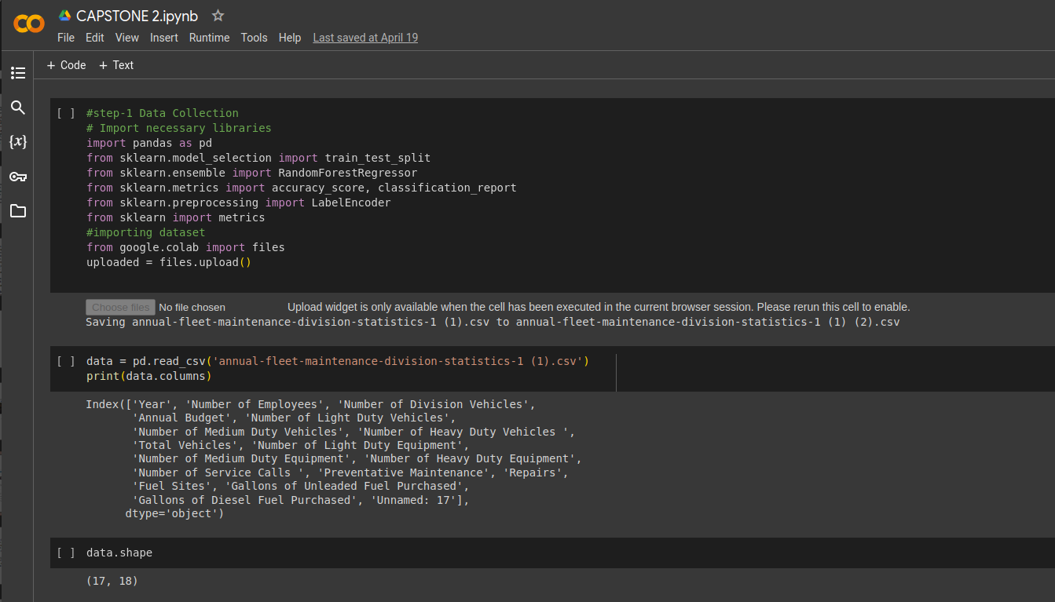
IMPLEMENTATION AND RESULTS

Slide 7
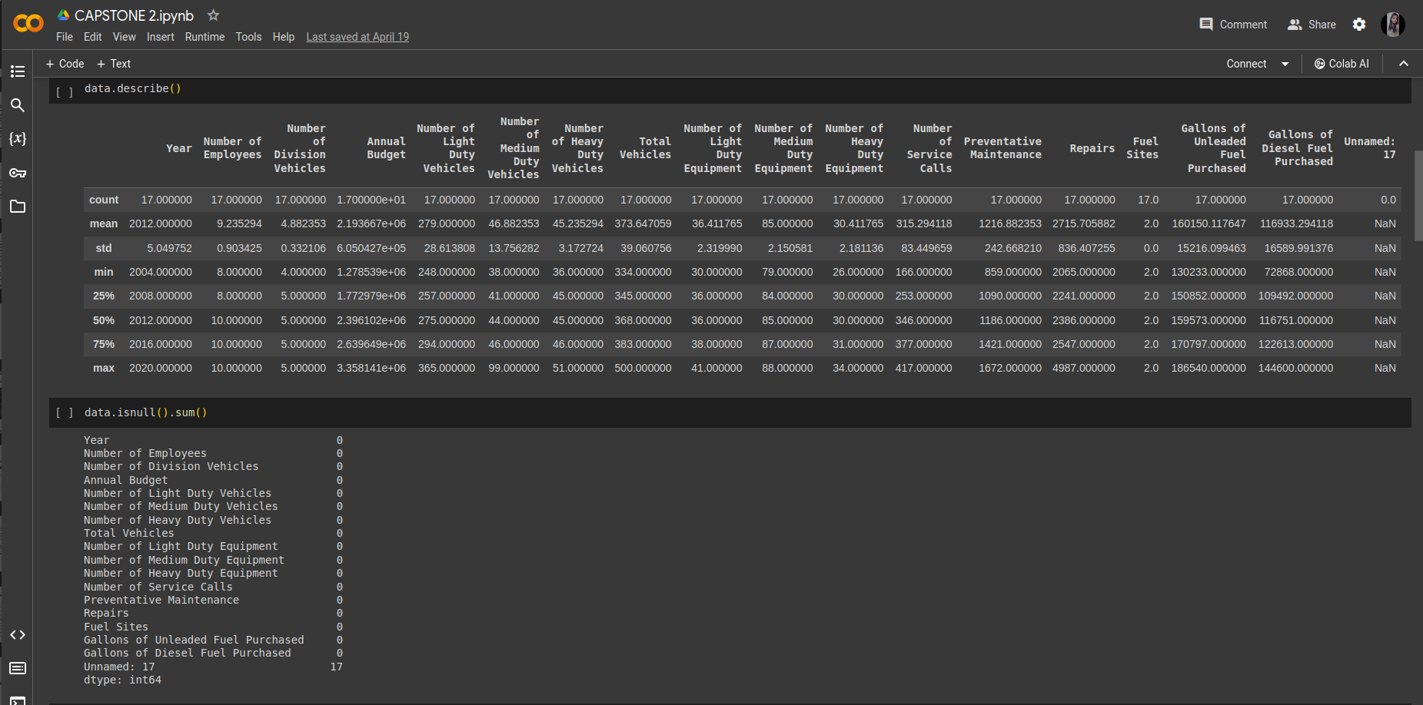

Slide 8
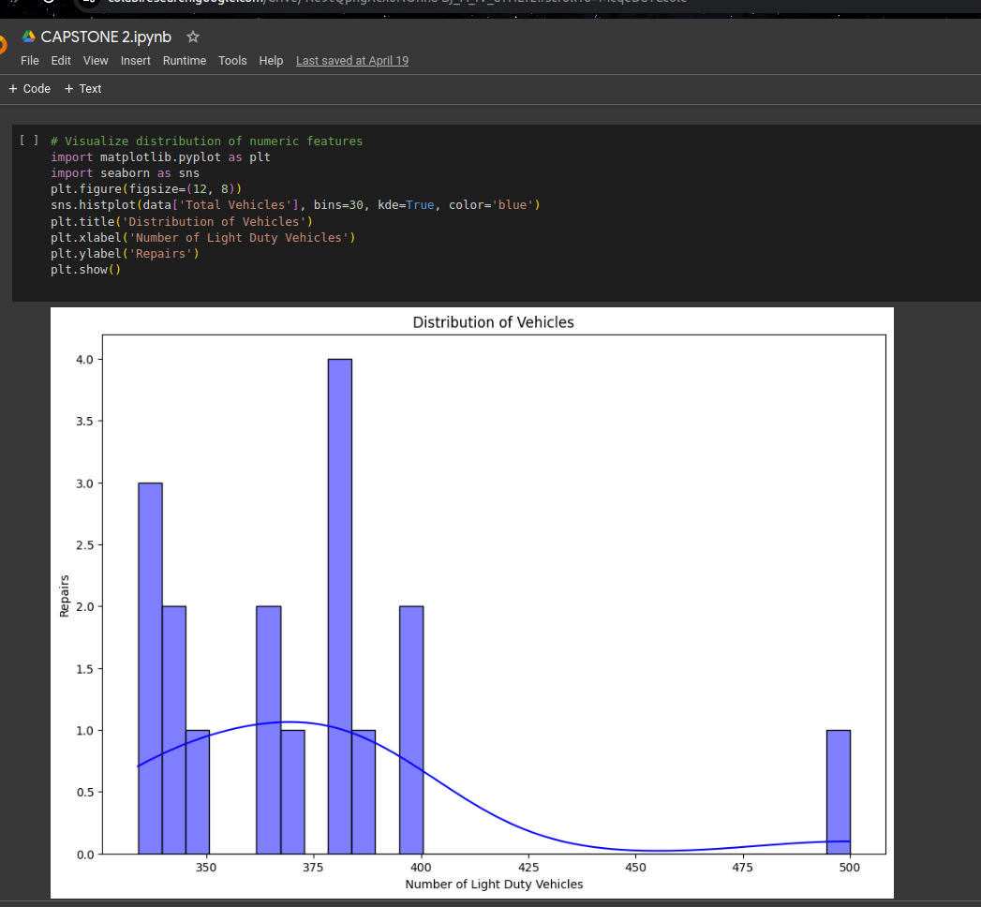
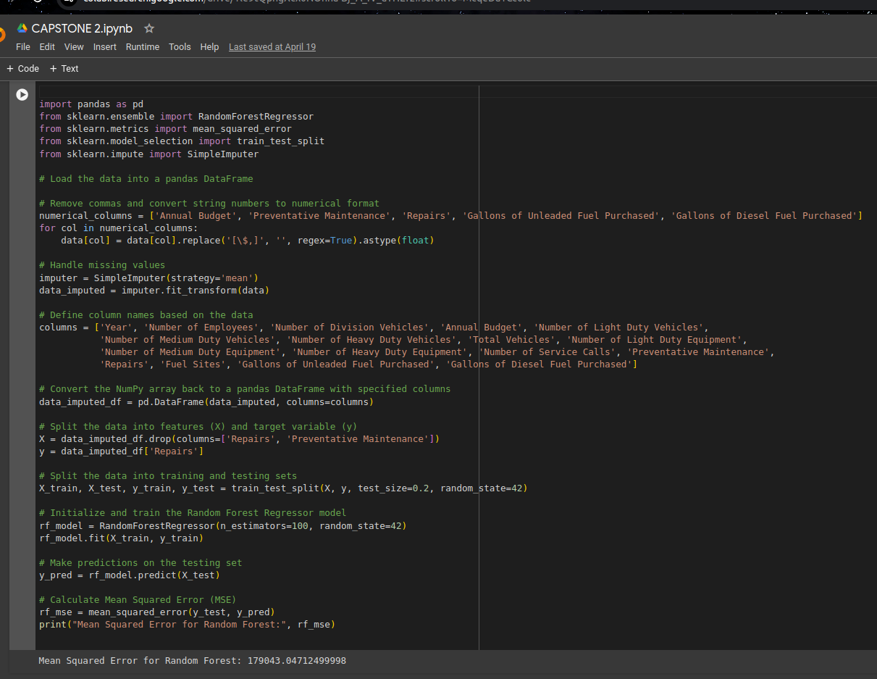

Slide 9
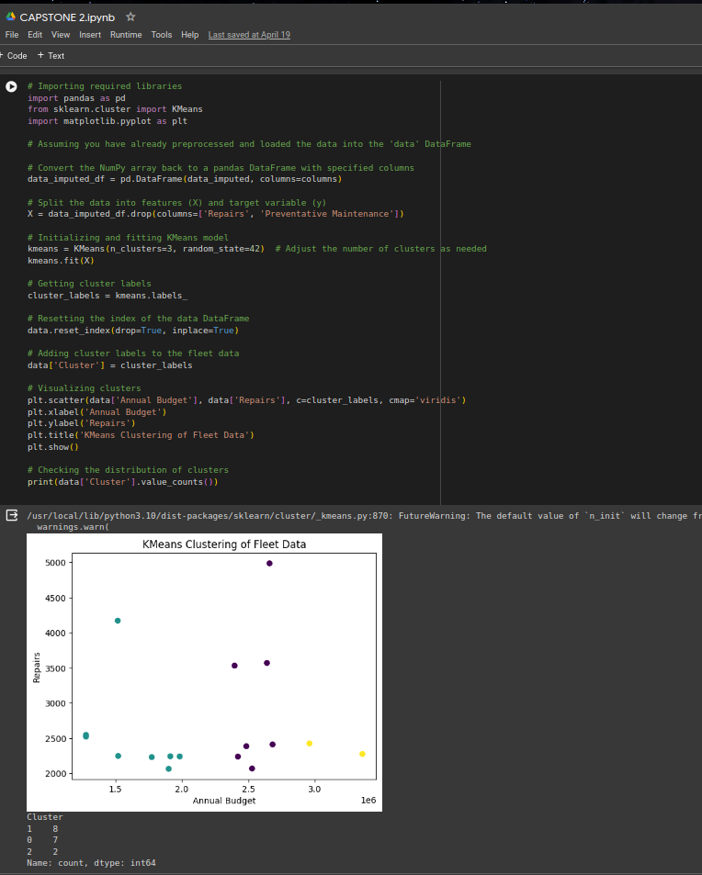
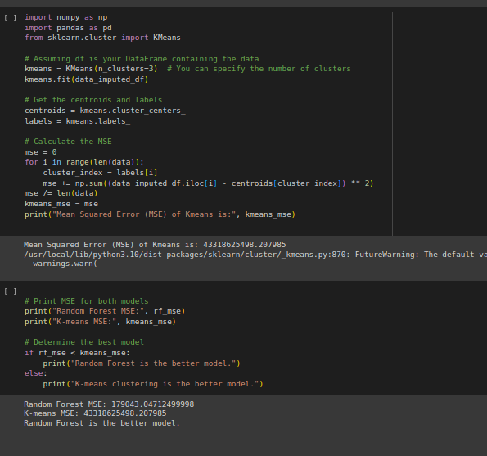

Slide 10
Future Scope
In the future, fleet management is set to benefit from advancements such as real-time data integration and AI-driven autonomous systems. Real-time data analytics will enable proactive decision-making, optimizing maintenance, fuel efficiency, and route planning. Meanwhile, AI-powered autonomous fleet management promises safer, more efficient operations, with predictive analytics forecasting demand and optimizing supply chains for improved performance and reduced costs.

Slide 11
References
[1] Bakdi, A., Kristensen, N. B., Stakkeland, M. (2022). Multiple Instance Learning With Random Forest for Event Logs Analysis and Predictive Maintenance in Ship Electric Propulsion System. IEEE Transactions on Industrial Informatics, 18(11), 7718-7728.
[2] Mallouk, I., Sallez, Y., El Majd, B. A. (2021). Machine learning approach for predictive maintenance of transport systems. In 2021 Third International Conference on Transportation and Smart Technologies (TST) (pp. 1-6). IEEE
[3] Taslim, H. A., Yahaya, N. A. Yahya, N. A. M. (2023). Supervised learning models for health condition-based classification of remaining useful life in predictive maintenance: A preliminary study. AIP Conf. Proc. 2808.
[4] Giannoulidis, A., Gounaris, A. (2023). A context-aware unsupervised predictive maintenance solution for fleet management. Journal of Intelligent Information Systems, 60, 521–547.
[5] Maktoubian, J., Taskhiri, M. S., Turner, P. (2021). Intelligent Predictive Maintenance (IPdM) in Forestry: A Review of Challenges and Opportunities. Forests,12(11).

Slide 12
Thank you and Any Queries

